Slide 1
COMP 2710 Software Construction
Call-by-Value vs. Call-By-Reference
Dr. Xiao Qin
Auburn University
http://www.eng.auburn.edu/~xqin
xqin@auburn.edu
Fall, 2012
These slides are adapted from notes by Dr. Walter Savitch (UCSD)

Slide 2
Parameters and Arguments
Confusing terms, often used interchangeably
True meanings:
  Formal parameters
    In function declaration and function definition
  Arguments
    Used to "fill-in" a formal parameter
    In function call (argument list)
  Call-by-value & Call-by-reference
    Simply the "mechanism" used in plug-in process
Copyright © 2008 Pearson Addison-Wesley. All rights reserved.
4-<number>

Slide 3
Call-by-Value Parameters
Copy of actual argument passed
Considered "local variable" inside function
If modified, only "local copy" changes
  Function has no access to "actual argument"
  from caller
This is the default method
  Used in all examples thus far
Copyright © 2008 Pearson Addison-Wesley. All rights reserved.
4-<number>

Slide 4
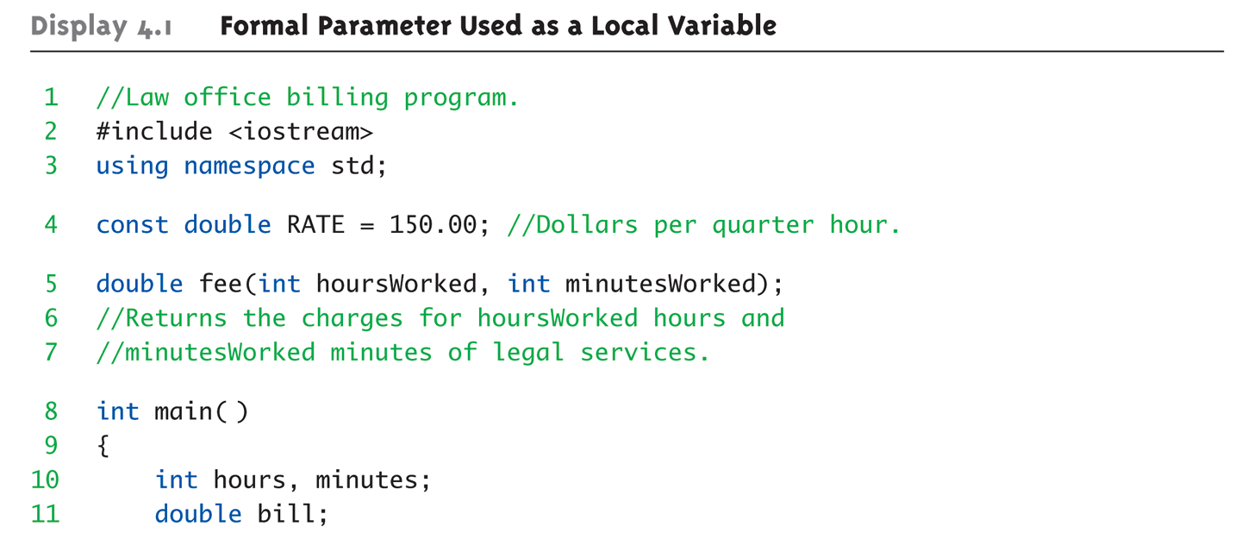
Call-by-Value Example:
Display 4.1 Formal Parameter Used as a Local Variable (1 of 3)
Are hoursWorked and minutesWorked parameters or arguments?
Copyright © 2008 Pearson Addison-Wesley. All rights reserved.
4-<number>

Slide 5
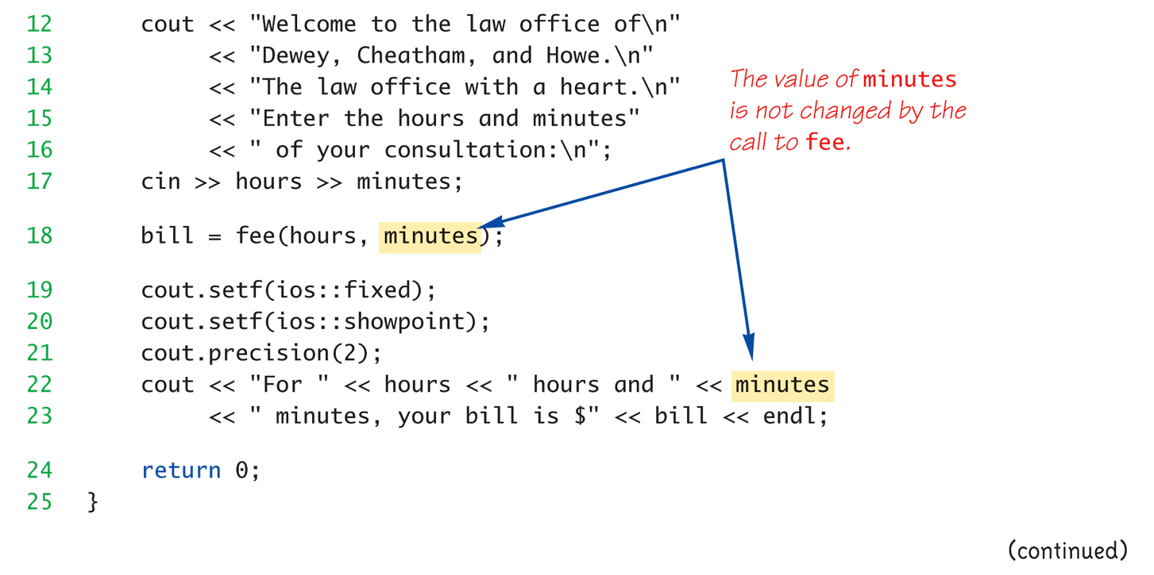
Call-by-Value Example:
Display 4.1 Formal Parameter Used as a Local Variable (2 of 3)
Are hours and minutes parameters or arguments?
Copyright © 2008 Pearson Addison-Wesley. All rights reserved.
4-<number>

Slide 6
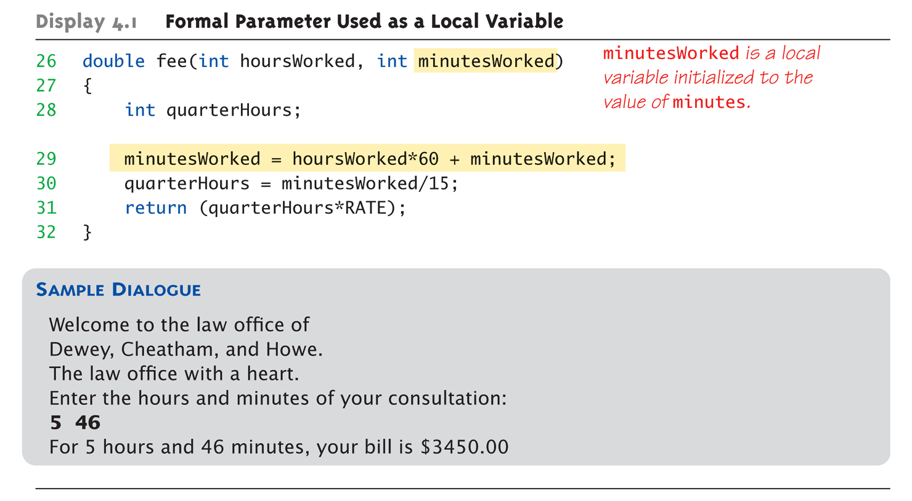
Call-by-Value Example:
Display 4.1 Formal Parameter Used as a Local Variable (3 of 3)
Copyright © 2008 Pearson Addison-Wesley. All rights reserved.
4-<number>

Slide 7
Call-by-Value Pitfall
Declaring parameter "again" inside function
Common Mistake:
  double fee(int hoursWorked, int minutesWorked)
  {
  int quarterHours; // local variable
  int minutesWorked // NO! Why?
  }
  Compiler error results
Value arguments ARE like "local variables"
  But function gets them "automatically"
    "Redefinition error…”
Copyright © 2008 Pearson Addison-Wesley. All rights reserved.
4-<number>

Slide 8
Call-By-Reference Parameters
Used to provide access to caller’s
actual argument
Caller’s data can be modified by called function!
Typically used for input function
  To retrieve data for caller
  Data is then "given" to caller
Specified by ampersand, &, after type
in formal parameter list
Copyright © 2008 Pearson Addison-Wesley. All rights reserved.
4-<number>

Slide 9
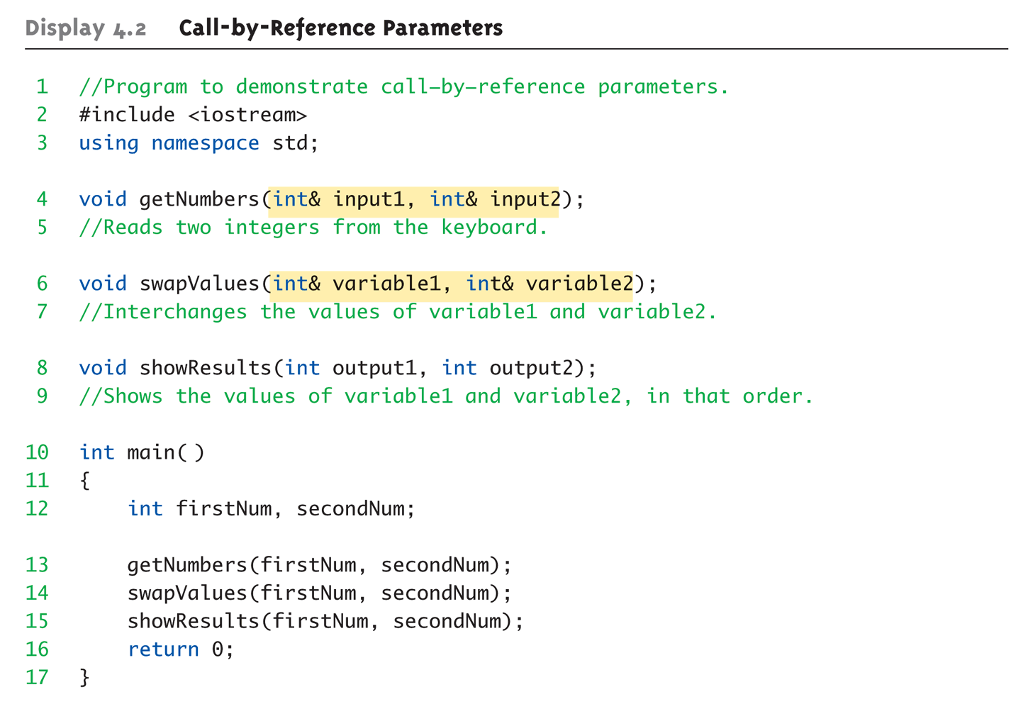
Call-By-Reference Example:
Display 4.1 Call-by-Reference Parameters (1 of 3)
Which are parameters?
Which are arguments?
Copyright © 2008 Pearson Addison-Wesley. All rights reserved.
4-<number>

Slide 10
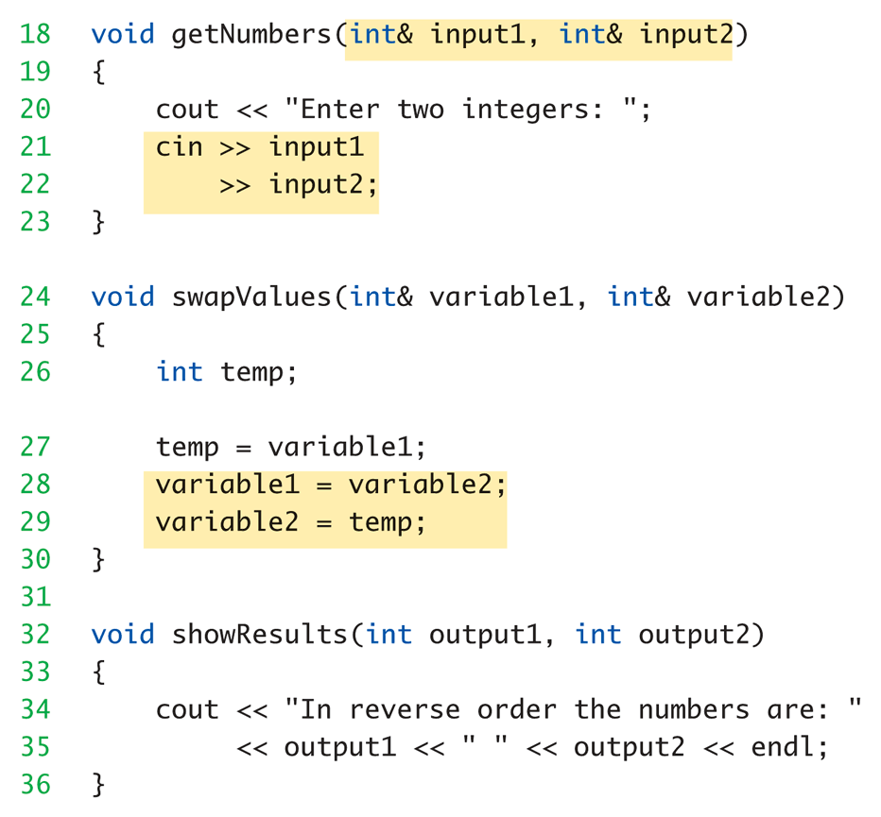
Call-By-Reference Example:
Display 4.1 Call-by-Reference Parameters (2 of 3)
Copyright © 2008 Pearson Addison-Wesley. All rights reserved.
4-<number>

Slide 11
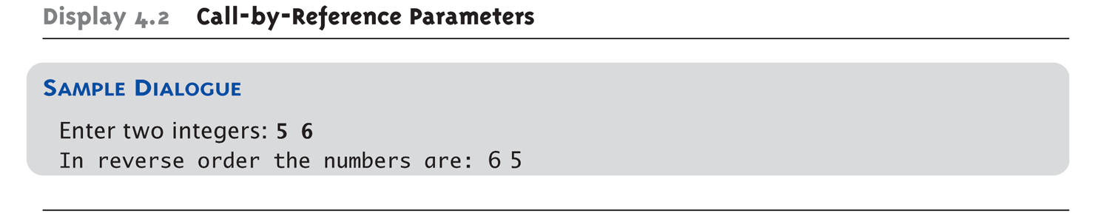
Call-By-Reference Example:
Display 4.1 Call-by-Reference Parameters (3 of 3)
Copyright © 2008 Pearson Addison-Wesley. All rights reserved.
4-<number>

Slide 12
Call-By-Reference Details
What’s really passed in?
A "reference" back to caller’s
actual argument!
  Refers to memory location of
  actual argument
  Called "address", which is a unique number
  referring to distinct place in memory
Copyright © 2008 Pearson Addison-Wesley. All rights reserved.
4-<number>

Slide 13
Summary
Parameters
  Call-by-value
  Call-by-reference
Copyright © 2008 Pearson Addison-Wesley. All rights reserved.
12-<number>

